Slide 1
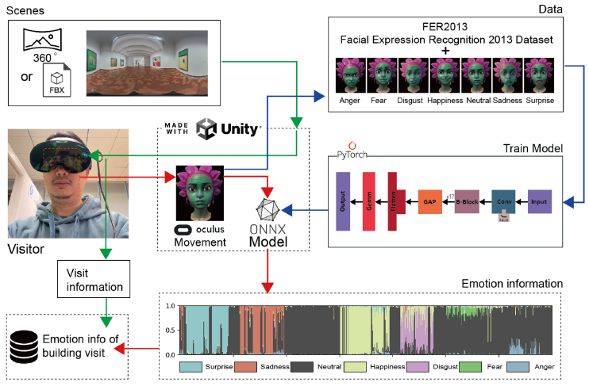
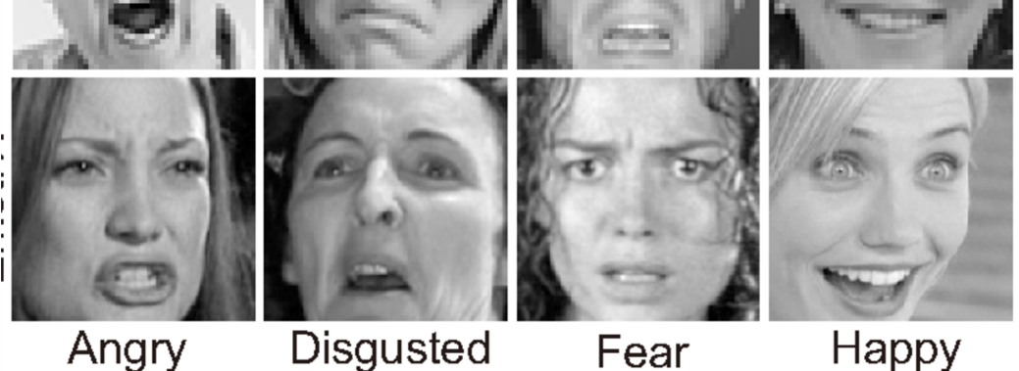



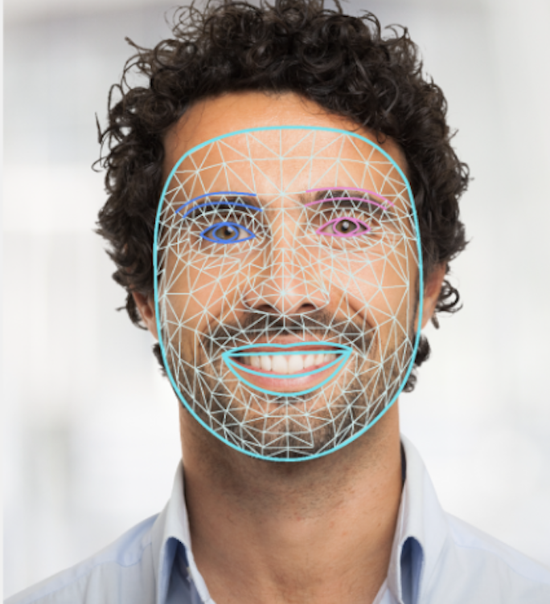

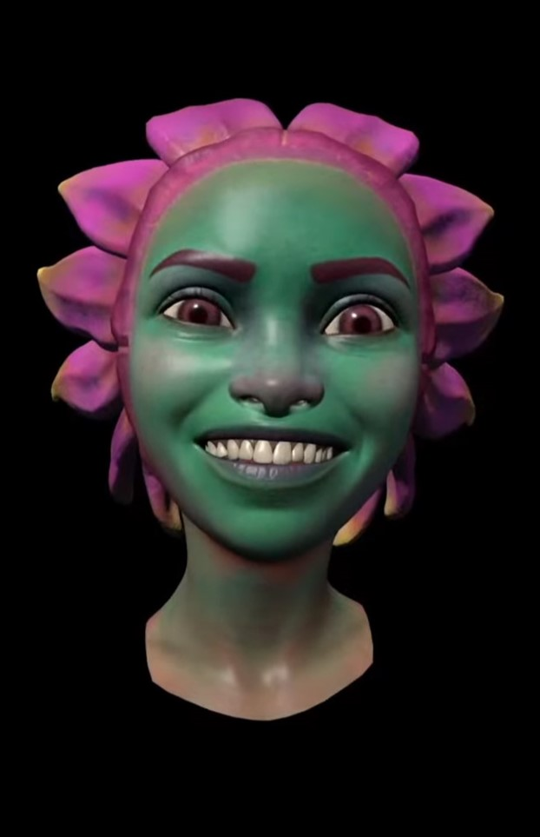
25-315
Emotion Recognition in VR with Advanced AI
Team members: Theus Frase, Philip Leake, Aryan Rathi, Youssef Bahloul | Faculty adviser: Kostadin Damevski Ph.D. | Sponsor: VCU College of Engineering
Motivation
To understand the emotional impact of certain interactions on team members or audiences whether at work or in an artistic setting, we need a tool that keeps users immersed while providing accurate emotion detection.
By coupling the immersive experience of VR with advanced emotion recognition AI, we can accomplish this.
Emotion Datasets
We are training models using PyTorch on three different types of labeled data: images of human faces, landmarks, and images of avatar faces. Using fer-2013, a dataset of 30,000+ images classified by emotion, as our dataset of human face images, we transform it to create the landmark and the avatar face images datasets.
Our goal is to determine
which of the three
datasets train a model
that is most accurate
and best performing
when running emotion
recognition inference
within VR.
Implementing Emotion Recognition in VR
To demonstrate the joining of VR and emotion recognition AI, we are using Unity to capture and display a person’s facial expressions under a Meta Quest Pro headset in real time. Using Unity’s Barracuda package, we are able to integrate machine learning models in ONNX format into the virtual environment and run inference on the captured facial expressions.

